Slide 1
Massachusetts Library System Council of Members Meeting
Hogan Center, College of the Holy Cross, Worcester
November 5, 2012

Slide 2
MLS Update
Annual Report
Strategic Plan 2013-2015
Plan of Service
Legislative Agenda fy2014
Notes:
It’s great to see you.
Thanks for joining us.
And thanks to those listening in remotely.
I’d like to provide an update on four MLS areas.

Slide 3
Annual Report
17 full-time and 2 part-time staff members
Executive Board
11 Committees
Delivered more than $95Million in services to 1,700 Members.
BiblioTemps Launch
Cooperative Purchasing with MHEC
Whately facility decision in fy2013
Joint Advocacy Pilot Program – Take Action!
Notes:
There is a brief annual report in your handout with statistics for services used by member along with quotes about services from our members.
I won’t read it to you, but I’d like to point out
The staff and management team are doing a tremendous job working with members, vendors, and colleagues to empower member libraries for success.
The Executive Board and Committee members add their expertise and dedication to keep MLS on track with member needs.
I am pleased to announce that in our preliminary look at the value of MLS services, that is what it would cost libraries to buy without MLS,
We’ve calculated that each dollar of state appropriations resulted in more than $14 worth of service.
Two new endeavors with tables
We launched BiblioTemps with one placement per week in the initial months, meeting member needs and later contributing to revenue for MLS to allow us to expand services.
We worked with the Mass Higher Ed Collab to launch supplies and materials coops that will provide significant discounts, simplified procedures, and greater buying power.
MLS is committed to maintaining an office in eastern and western Mass. You may be aware that the Western Mass. Reg. Lib System built a facility in Whately in 2006.
We are only using a small part of this building. There is a significant amount of surplus space that carries significant cost for mortgage and upkeep.
We have tried to find a tenant to make this building cost effective without success. Worked with WMLA to petition Congressman.
We need to make a decision during this fiscal year to allow MLS to run cost effectively and target use of funds in the best way to benefit members.
Joint Advocacy Pilot Program – Take Action!

Slide 4
Strategic Plan
A shared vision for MLS to empower member libraries for future success.
Thanks to the Planning Task Force members.
Hundreds of members provided input.
Staff, Committees, and Executive Board.
MLS makes libraries and librarians stronger.
Notes:
Our Brand new Strategic Plan reflects a shared vision for MLS to empower member libraries for success.
We had a lot of help.
Hundreds of members provided input.
The Task Force members represented all types and all parts of the Commonwealth and did an excellent job in planning the process, participating in information gathering and analysis, and finalizing the document.
The Ex Bd, Committees, and Staff all provided additional input.
You all have a copy of the single-page snapshot view of our Plan
We have reconfirmed the MLS Mission established by the MLS Planners
We’ve added a tag line- MLS makes libraries and librarians stronger
We have added one core service—BiblioTemps

Slide 5
Five Strategic Objectives
Expand Online content
Enhance Practical resource sharing
Develop Connections
Underserved audiences targetted
Branding & communications plan
Notes:
In the interest of time, I’m going to jump right to the Strategic Objectives. These are listed in the introduction to the fy2014 POS.
Expand access to electronic content
Enhance access to resource sharing options
Develop connections between member libraries
Implement targetted services and communications with underserved audiences
Launch MLS brand & communications plan

Slide 6
Play a leading role in expanding access to econtent and its discovery by Massachusetts library users
What percent of your library’s materials budget is invested in eContent?
Notes:
I’d like to start with the objective:
Play a leading role in expanding access to econtent and its discovery by Massachusetts library users.
I’d like you to think about how much your library invests in eContent.
How many of your libraries spend 25% of your budget on eContent?
How many of you expect this to shift above 25% in the next three years?

Slide 7
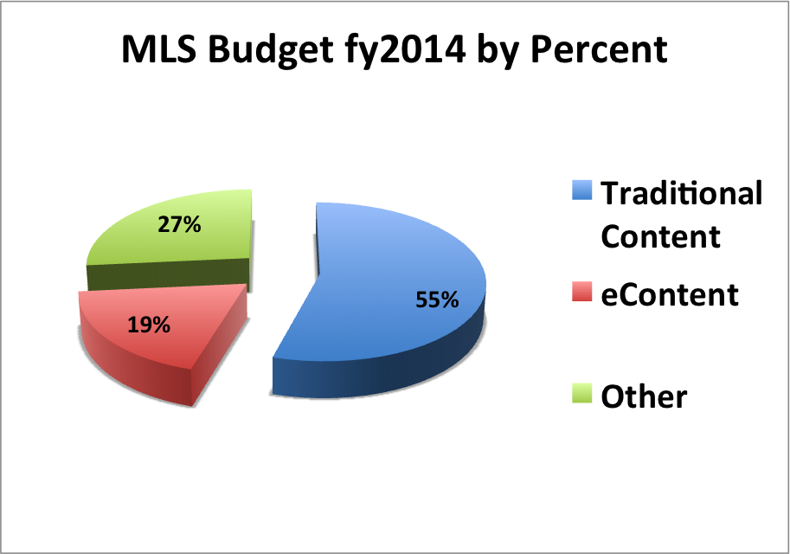
Notes:
Here’s where MLS stands.
Blue – 55% - Supplying Content through Physical Delivery and Mediated ILL/Doc Del.
The level Physical Delivery and Traditional library circulation are flattening nationwide.
Granted the numbers are huge! And traditional materials remain essential and will remain so for a long time.
Red is MLS investment in statewide licenses in partnership with MBLC. We need to look at expanding this.
Libraries need to meet a skyrocketing demand for econtent and we at MLS want to help.
MLS can’t do it all (not by any stretch of the imagination.)
May I throw a few more numbers at you?
Statewide Public Library acquisitions budgets total about $33 million per year according to the most recent compilation of data.
Investment in shared Overdrive ebooks by the Automated Network members was estimated at less than $1 million or about 3%
How many of you think this percentage should be higher?

Slide 8
Statewide Resource Sharing Committee
eBook Platform Proof of Concept
MLS role
Library contributions
Discussions Starting Soon
Statewide Discovery Platform
Statewide Library Card
Notes:
Let’s talk about ebooks.
You might have noticed that we have included online content under resource sharing in our list of core services.
Our ability to be as successful with resource sharing in Massachusetts as we have in the past is contingent on our ability to provide wide access to eContent.
This is a nationwide & worldwide dilemma.
MBLC formed the Statewide Resource Sharing Committee
MLS is participating actively on this Committee
You may have heard that we are working on a proof of concept for a statewide ebook platform based on the Douglas County Model that Jamie LaRue described at the Resource Sharing Unbound event here in Worcester last May.
We hope to launch a prototype by Spring 2013 with 50 participating libraries.
It is an exciting first step toward reducing the silos of content that might inhibit Massachusetts resource sharing.
It seems that statewide collection development is a direction to avoid a barrier to ILL.
The issues we face go far beyond technology.
Library relationships with the publishing industry are being examined.
We need to work together to solve this critical issue.
I think libraries will come to a win-win solution with publishers.
Jamie LaRue from Colorado is paving the way with his model.
The American Library Association is working on our behalf, as are many passionate librarians around the world.
Soon, we’ll be asking libraries to do your part in a statewide solution. The Statewide Committee envisions a $2million/year budget for content as our starting point.
We need to allow statewide access for this important project.
We’ll need libraries of all types statewide to pay their fair share to make it a reality.
Also beginning discussions on:
Discovery Platform
Statewide Library Card

Slide 9
MLS Online Content Advisory Committee
Online newspapers debriefing
Prioritize and plan Collaborative Purchases
We need your help. Please response to our calls for participation
Notes:
MLS Online Content Committee
Newspapers a high priority for the Committee and Executive Board.
We hoped to continue statewide access for ProQuest’s Mass. Newsstand.
Unfortunately, we were unable to raise enough funds through this PBS model to license NewsBank or ProQuest titles.
We’ll be working with the MLS Online Content Advisory Committee to
gather information about member needs and to
prioritize our efforts.
We need to focus where we can do the most good.
MLS is in a unique position to work with members to provide statewide access to content.
There is a potential to add content that will be available to all Mass residents via geolocation and
Later through the statewide discovery platform and I hope, eventually via mobile devices.
No log in would be required.
We also need to gather a great deal of information about your libraries and your libraries' needs.
Please respond to our calls for participation in surveys and, if pledging is called for, for pledging.
As the Statewide Resource Sharing Committee will seek a model for assessing libraries to cover the cost for ebook collection development,
Let’s consider if MLS should do the same to make other online content instantly accessible to all of your patrons wherever they are whenever they need it.

Slide 10
Enhance access to practical resource sharing options for Massachusetts residents
MLS Vision for ILL
MLS members participate in ILL on a reciprocal basis for all permitted library materials, including online content.
MLS provides ILL services in an efficient manner balancing the workload and costs among MLS, borrowers, and lenders appropriately.

Slide 11
Practical Resource Sharing Options
MassCat
Reducing prices
Virtual Catalog
Wider participation
Delivery
Provide to libraries that share
Mediated ILL
Discussing consultant’s report
Expanding access within and beyond Massachusetts
Notes:
Reducing costs to join MassCat to encourage membership for small libraries.
MassCat will become part of a new Statewide Virtual Catalog over the next year or two.
This opens the virtual door to the holdings of over three hundred libraries to Massachusetts small libraries.
When libraries participate in resource sharing we need to include them in MLS Delivery service
MLS contracts with the public libraries in Quincy and Wellesley for mediated ILL services.
They are doing a fine job. Member satisfaction with this service is high.
However, these transactions are much more expensive than the direct lending that occurs between members of networks and through the Virtual Catalog.
MLS commissioned a study and the Resource Sharing Advisory Committee if reviewing the results.
Under consideration are moving as much lending as possible to a self-service model to take a step out of the process thereby reducing the turnaround time and cost
We are looking at bringing this service in house to allow MLS to stay close to the service and allow nimble reaction to change
Prior to the consolidation, libraries in central and western Mass. used an in-house model.
We will have a decision on this sometime this fiscal year.
As we look within Mass MLS member connections to non-networked academic libraries is light. The new virtual catalog will open up access when stand-alone systems join.
The cost of a mainstream Massachusetts loan for delivery and internal library costs is about 44 cents for the delivery and about 2.50-3.00 for library labor.
I believe we need to examine the possibility of reducing the costs for lending with neighboring states. The current cost for a mediated loan from NY is over $20.
We plan to explore a delivery connections that could reduce these costs significantly.
Perhaps the new Virtual Catalog and new partnerships can open these doors.

Slide 12
Develop connections between member libraries to expand their contributions to the MLS community
Sharing expertise and resources
Peer training
Networking
Library Leadership Institute
Notes:
Connections
Sharing expertise and resources
Peer training
Networking
Library Leadership Institute

Slide 13
Explore and implement communications channels and targeted services for underserved audiences
Analysis in progress
Prioritize steps
Focused activities
Identify/develop services that are valued
Notes:
Target Underserved Audiences
With communications and services
Team

Slide 14
Plan and launch an MLS brand to carry our message to all stakeholders
Brand and look for MLS
How will services fit?
MassCat
BiblioTemps
Library Reading Program
Library Delivery
Online Content
Plan effective communications with all stakeholders
Notes:
Branding and Communications Plan

Slide 15
Plan of Service & Budget fy2014
Membership approval at Business Meeting
Delivering core services
Budget increased by $100,000
New Positions
eContent Management
Support Staff
Implementation of Strategic Initiatives
Notes:
Significant changes to budget and plan approved last year.
Cheryl Coakely-Rivera Amendment $100,000 – a great start!
Need to focus on eContent – eBooks, databases, collaborative purchasing
Support – let professionals focus where most effective, more virtual training
In addition to core services and implementation of strategic objectives.
You will be asked to approve the Plan of Service and Budget
Questions?

Slide 16
Legislative Agenda fy2014
Three Priorities for a 12% Increase - $843,000
eContent
Helping libraries transition with skyrocketing demand
Training, Professional Development, & Advisory
Expand availability, locations, and variety
Practical Resource Sharing Options
Expand MassCat, Mediated ILL, Delivery
Notes:
Lost 40%
Value up 50%
Efficient
Need to do more

Slide 17
Be an Advocate for Libraries
MBLC Legislative Agenda
Legislative Breakfasts (Jan-Mar)
MLS/MSLA Legislative Day (Mar 26)
At your convenience
Tell your library story
Libraries are essential!

