Slide 1
Living in the Future
Libraries Supporting the Next Wave of Cultural Evolution

Slide 2
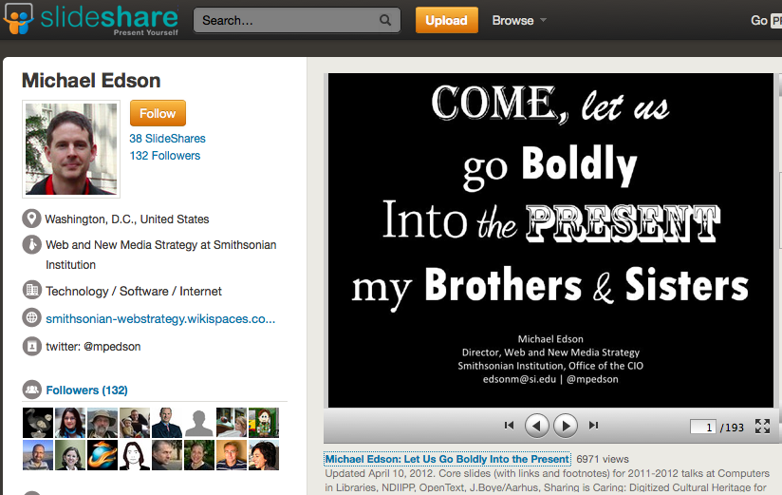
http://www.slideshare.net/edsonm/michael-edson-let-us-go-boldly-into-the-present-text-version
Notes:
http://www.slideshare.net/edsonm/michael-edson-let-us-go-boldly-into-the-present-text-version
We are living in our own future. If you’d asked an educated adult in the early 1980s “Will you ever be able to hold a supercomputer in the palm of your hand, with instant access to a worldwide network of information?” You’d probably get a good laugh and a “What do you think this is, Star Trek?” Yeah, the joke’s on us.
We are living in that science fiction future right now.

Slide 3
“It’s amazing to consider that a particle physicist, a molecular biologist, and someone lying on a beach with a novel by Stephen King may all be reading from the same device and purchasing their content from the same venue.”
Joe Esposito, Predicting the Present
http://scholarlykitchen.sspnet.org/2012/03/19/predicting-the-present/

Slide 4
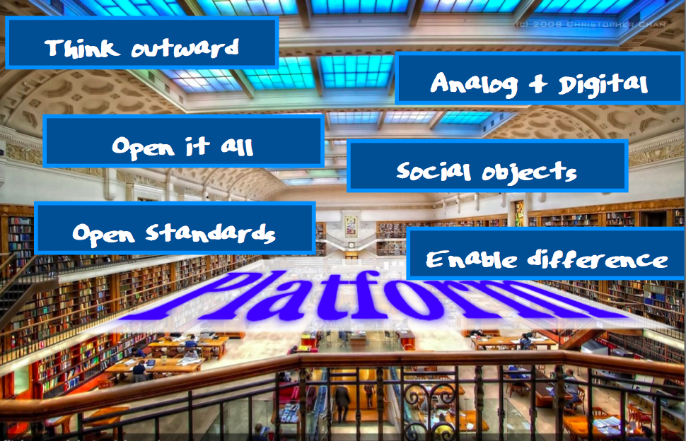
http://www.infotoday.com/il2012/presentations.asp
Notes:
David Weinberger – author of Too Big To Know, Everything is Miscellaneous and others – gave the opening keynote at Internet Librarian. He talked about the Library as a Platform, a platform for us and for our users/patrons to create and develop and learn on. This is nothing new – Weinberger even mentioned that – but what is new is the myriad ways in which we can do this. We can do it just by making our existing stuff easier to find and use, and by adding services that support our users in doing what they want to do.

Slide 5
Libraries
Social Media
Online Spaces
Users as Makers
Users as Creators
Physical Spaces

Slide 6
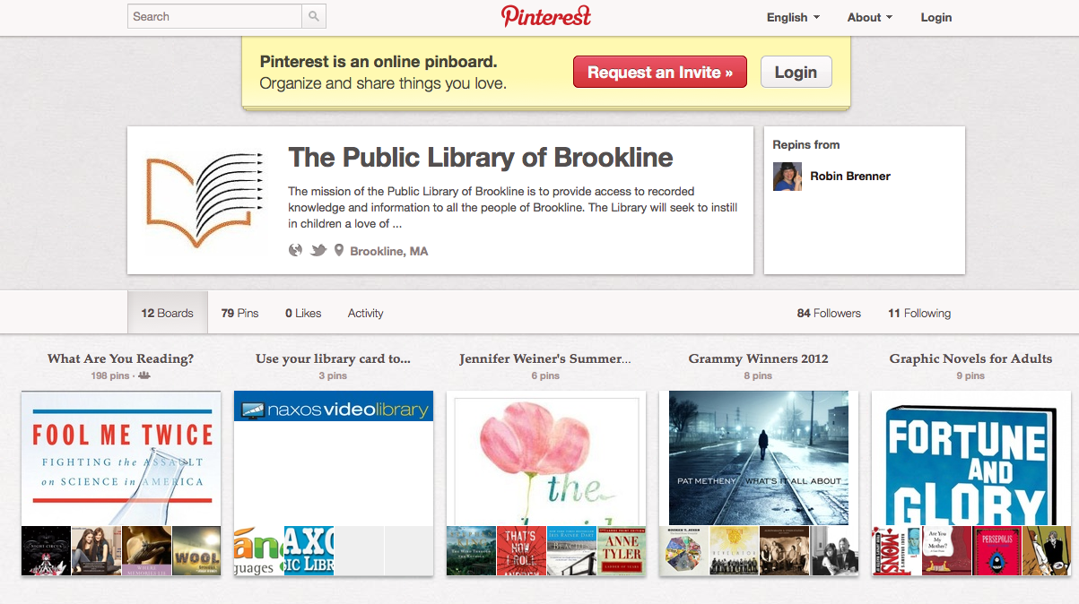
Notes:
http://www.onlinecolleges.net/2012/03/12/20-great-ways-libraries-are-using-pinterest/
http://pinterest.com/brklib/
NYPL labs
It is a poster child for the cloud – the company is basically some engineers, some business people, and all their computing is in the cloud, specifically Amazon Web Services.

Slide 7
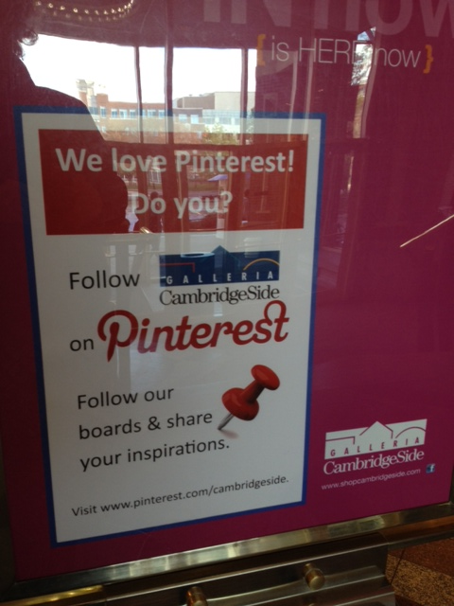

Slide 8
Online Spaces

Slide 9
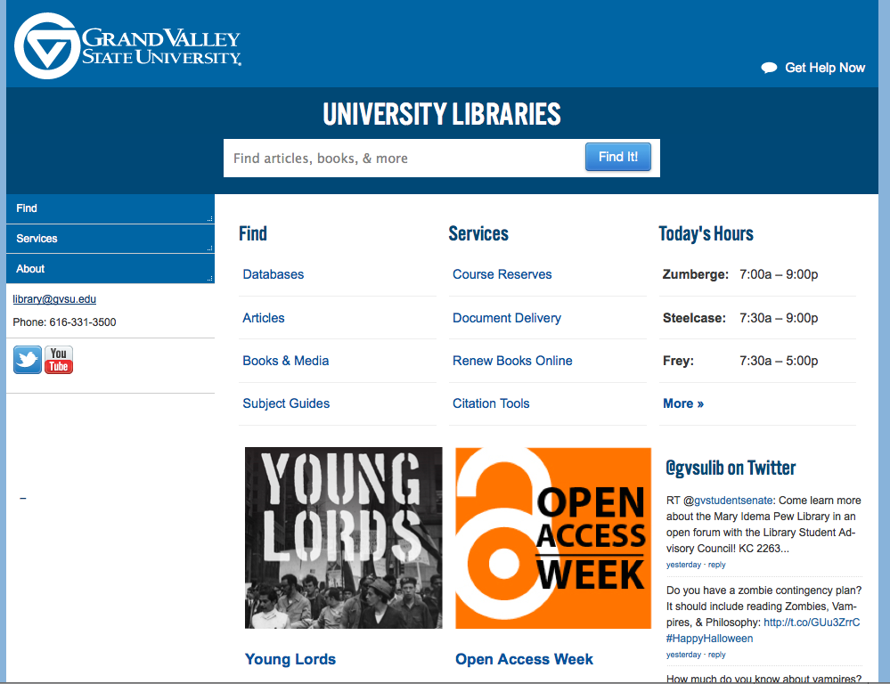
Notes:
First, our websites can be more future-proof using responsive design. The site itself ‘knows’ what kind of device is viewing it, and can resize and re-lay out the site dynamically to best be viewed on that device.
Full site for large screens

Slide 10
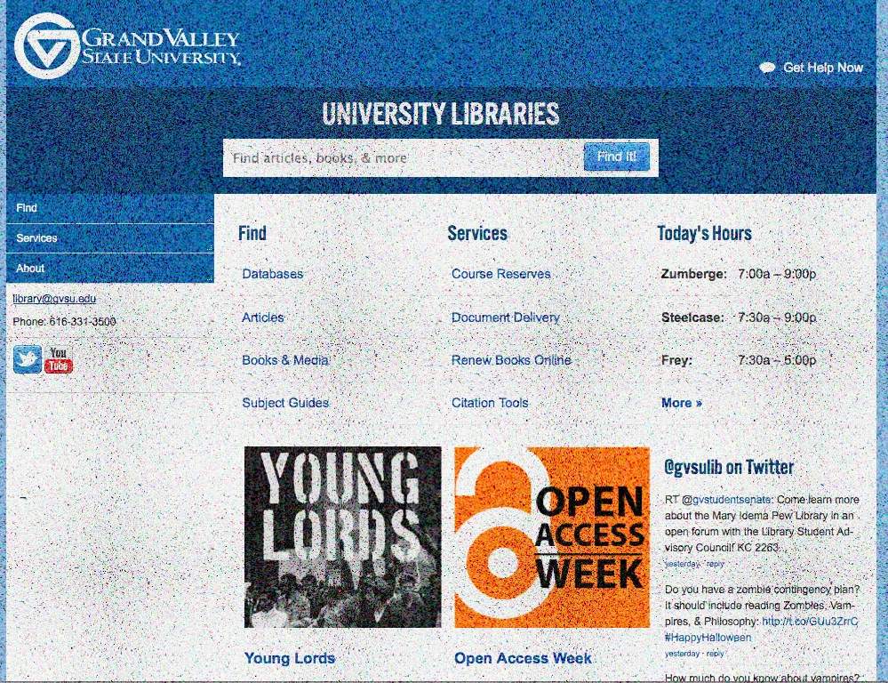
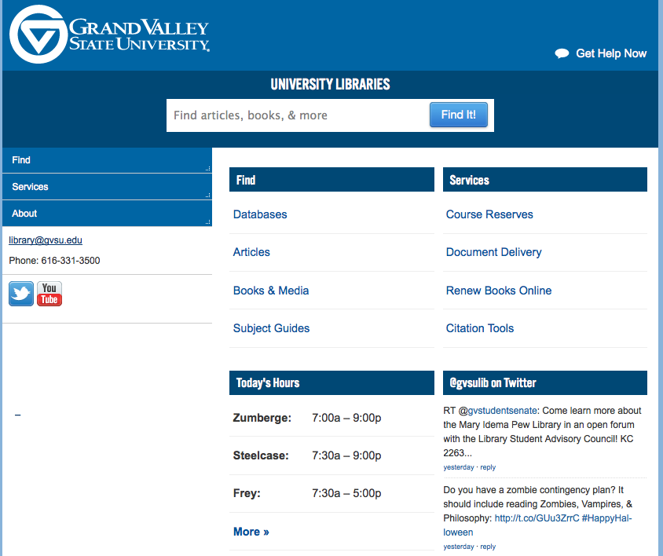
Notes:
If you have a slightly smaller monitor/laptop

Slide 11
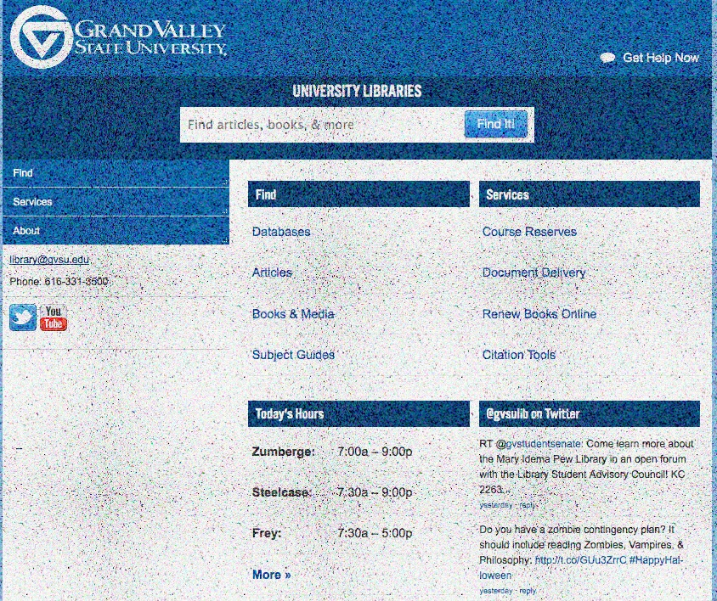
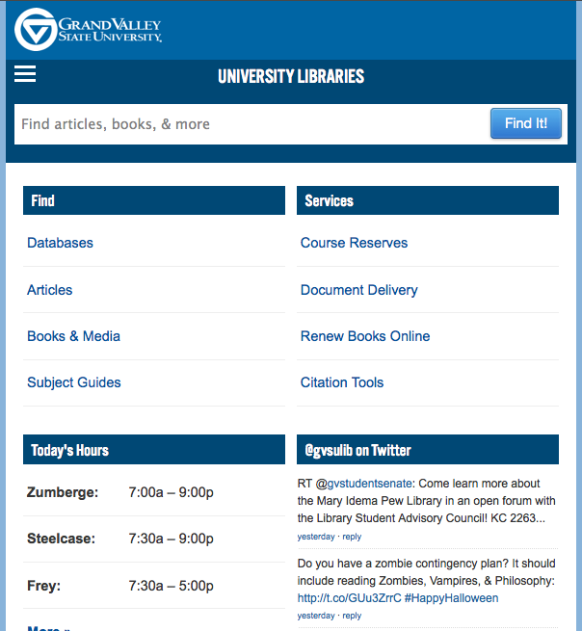
Notes:
Tablet

Slide 12
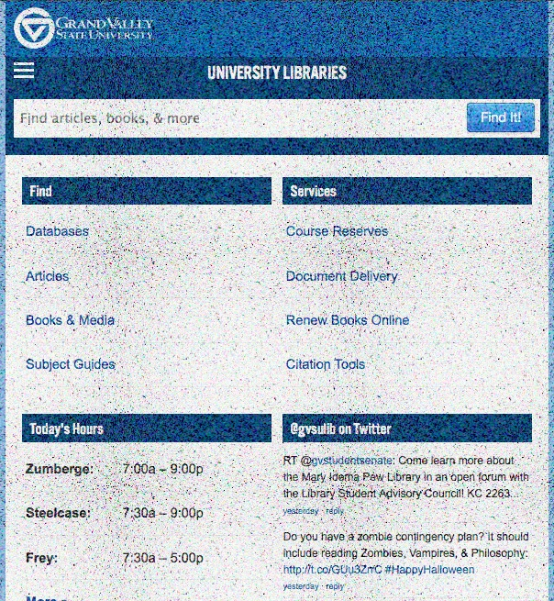
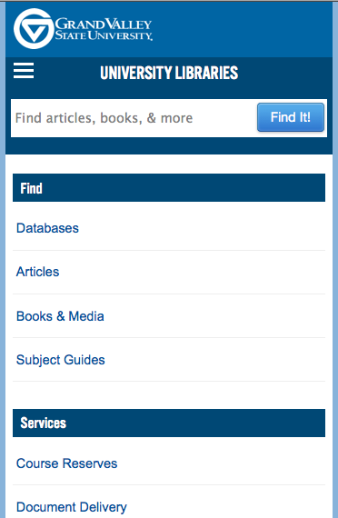
Notes:
Smart phone

Slide 13
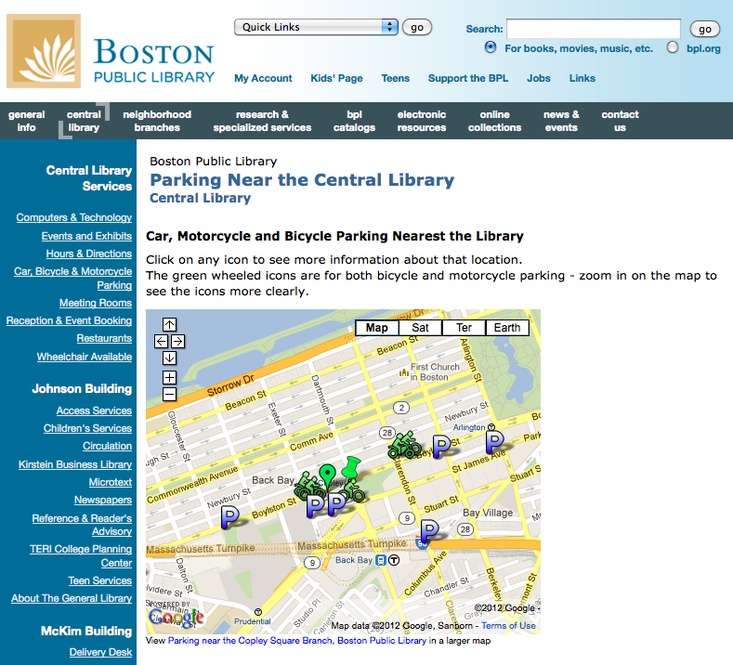
Notes:
Much more simply, use cloud-based tools like Google maps to offer better information about your organization or surrounding. Parking map I created for the BPL.

Slide 14
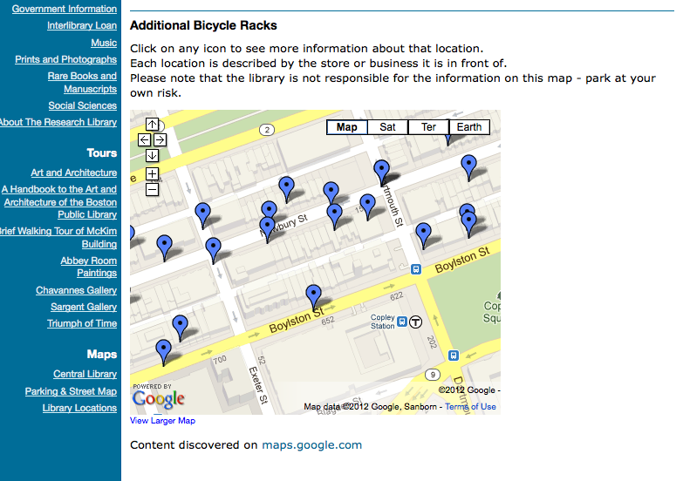
Notes:
And one I found that someone else had created. www.bpl.org

Slide 15
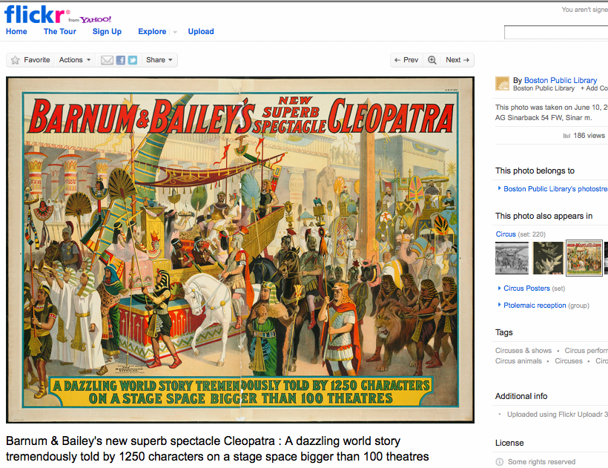
Notes:
Putting our collections and digitized objects online using Flickr

Slide 16
Notes:
Using a self- or web-hosted platform like Omeka.org
http://exhibits.congregationallibrary.org/

Slide 17
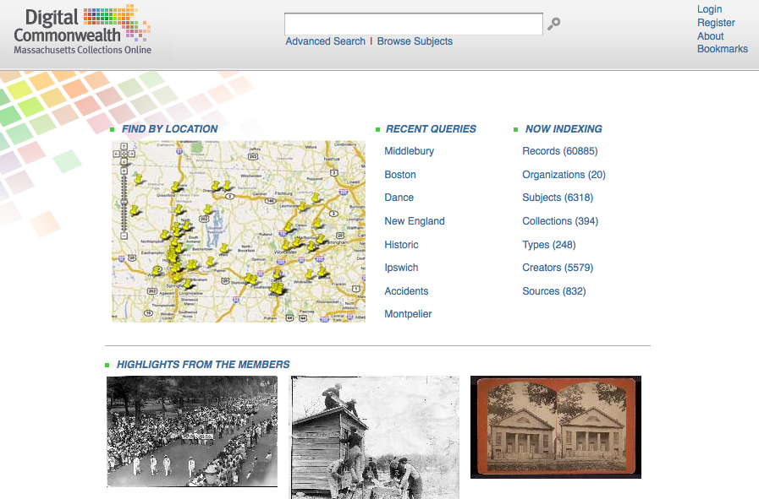
Notes:
Collaborating together into large repositories like the one being built for the Digital Commonwealth
http://www.digitalcommonwealth.org/

Slide 18
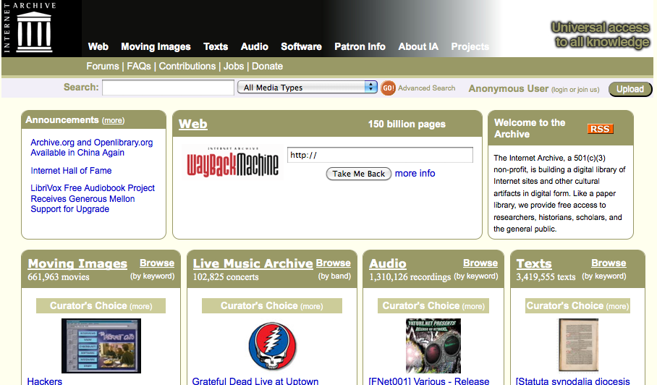
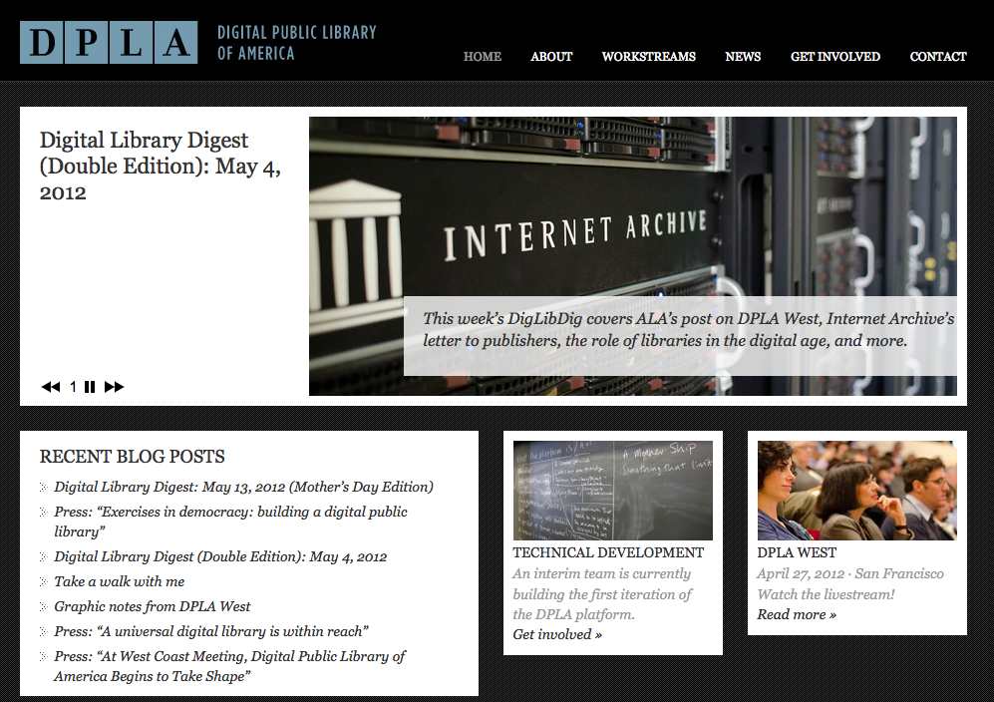
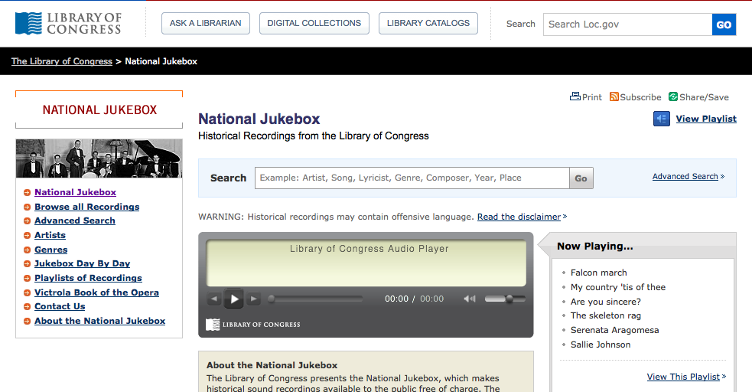
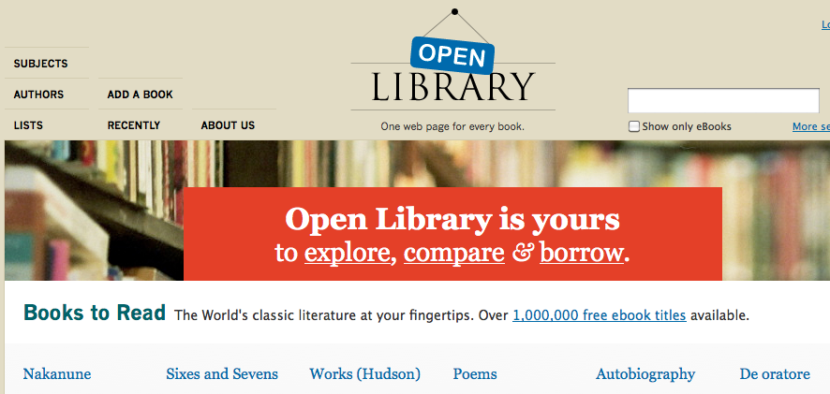
Notes:
Or in national/international initiatives and platforms
Archive.org
Openlibrary.org
http://dp.la
http://www.loc.gov/jukebox/

Slide 19
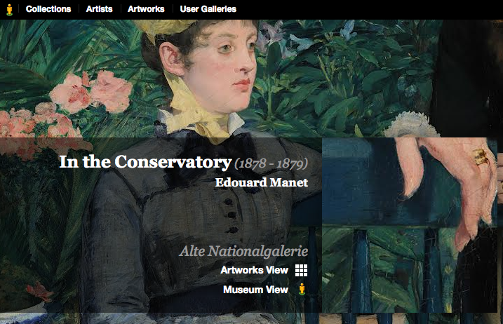
Notes:
http://www.googleartproject.com/
MBTA – inside stations
Heard about Inside Libraries initiative – BPL recently participated, so that in a few weeks, Android device users can actually use Google Maps on their device to get turn-by-turn directions *inside* the BPL. Google’s initiative that we can benefit from.

Slide 20
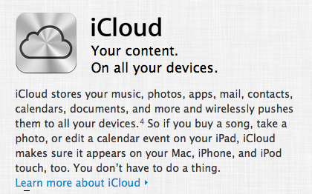
Notes:
Data – DropBox iCloud MSLive Amazon Cloud
As a collaboration tool –
Michael & I working on personas workshop
Maurice sharing the Polaris training tools with me
The folder for the music at SpinJam
LOCKSS lots of copies keeps stuff safe - Lockss.stanford.edu

Slide 21
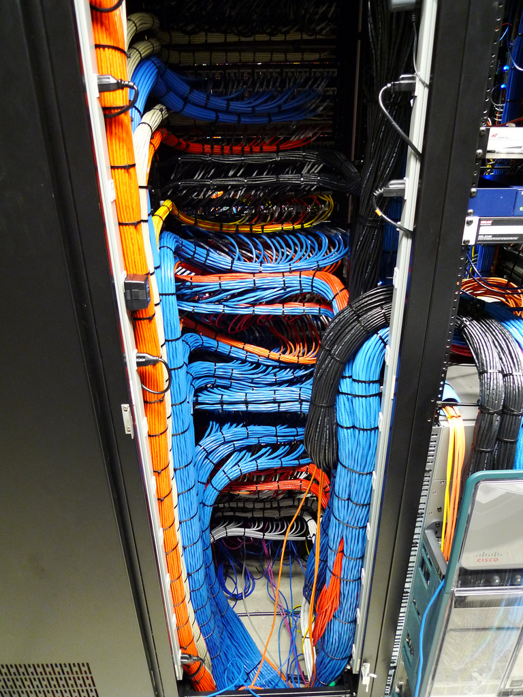
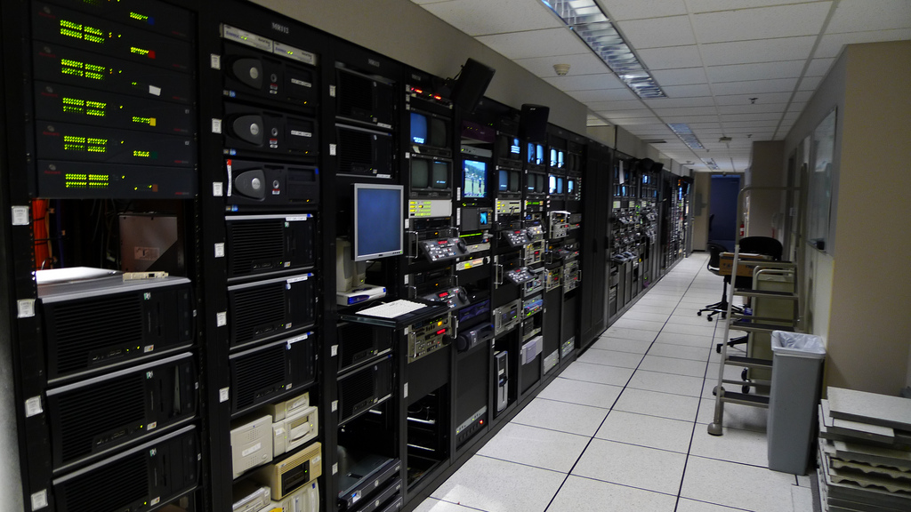
Notes:
Amazon Web Services – server time
Computing time
Storage & backup
Database & website hosting

Slide 22
Physical Spaces

Slide 23
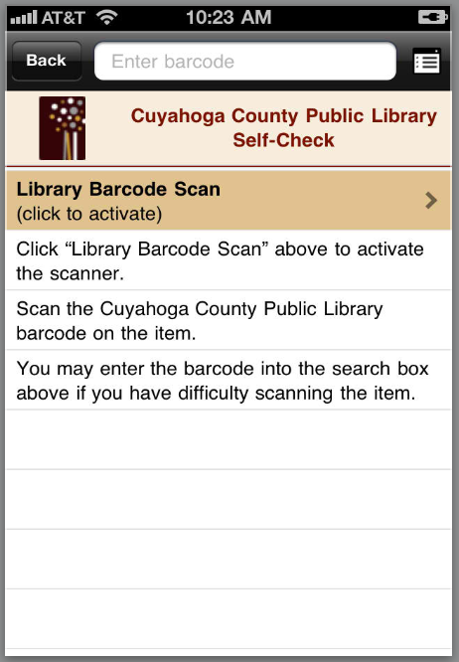
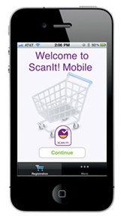
Notes:
http://www.stopandshop.com/our_stores/tools/scan_it_mobile.htm?svcid=SCAN_IT_MOBILE#
Post about it at blog.bpl.org/lifeonline

Slide 24
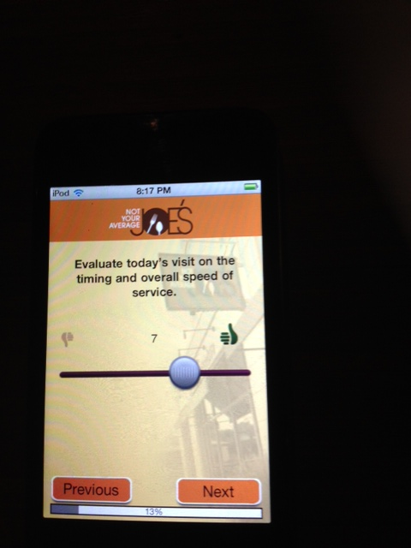
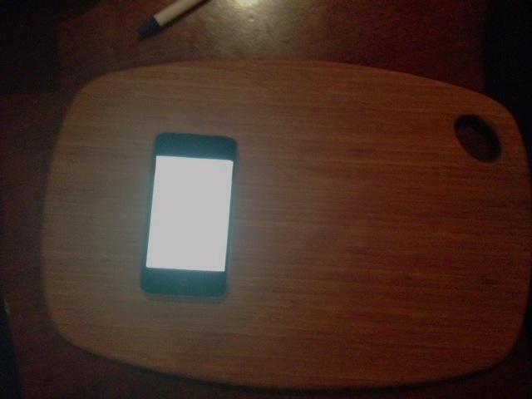

Slide 25
New (to us) Technology – University of Calgary Libraries
Touch tables (stand-up and coffee)
Touch kiosks to control Media Wall
Digital signage running Omnivex Moxie
Media Walls
Touch Room Booking Displays
Christie MicroTiles
Visualization Wall
Magic Planet Spherical Display
A/V Editing Suites
Digital Media Commons
Teamspot Collaborative software
Dual-boot Mac Minis in Collaborative Workrooms
Large format Scanner
Gaming Collection (current and retro)
Off-site storage of 80% of the physical collection
Dual-monitors
OSX machines
http://www.infotoday.com/il2012/presentations.asp
Notes:
Paul Pival’s presentation “Tomorrow’s Digital Libraries Today” http://www.infotoday.com/il2012/presentations.asp

Slide 26
Notes:
http://www.librarylab.org/
http://plablog.org/2012/02/a-two-part-plan-to-make-your-library-a-local-publisher.html

Slide 27
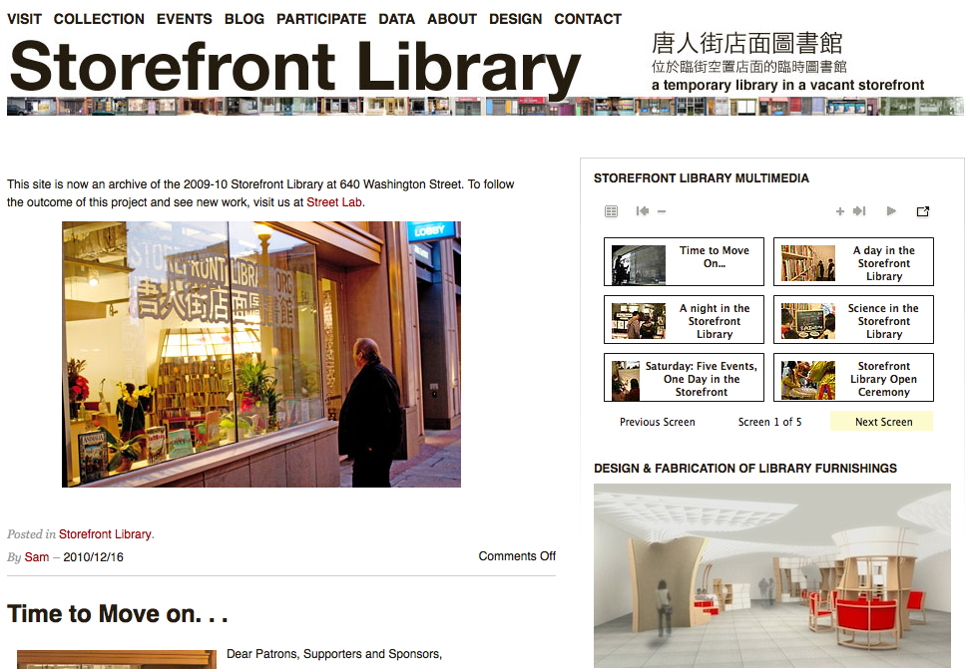
Notes:
http://www.storefrontlibrary.org/
http://www.bostonstreetlab.org/

Slide 28
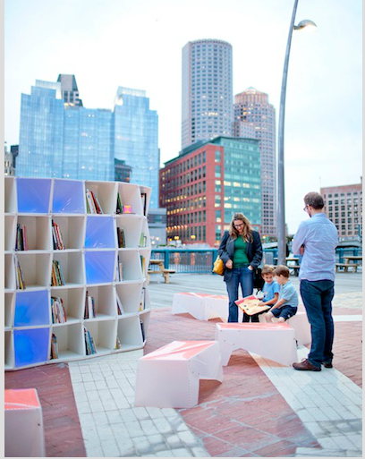
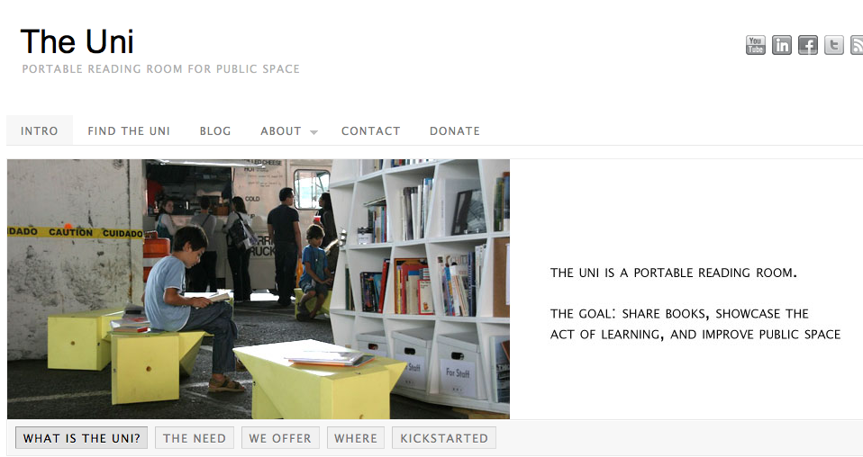
Notes:
http://www.theuniproject.org/
The Uni Project aims to do one thing and do it well: temporarily transform almost any available urban space into a public reading room and venue for learning. We start with the conviction that books and learning should be prominent, accessible, and part of what we expect at street-level in our cities.
The purpose of the Uni is to share books, showcase the act of learning, and improve public space. It is intended to be a new resource for a city, providing residents with a place to gather and contribute to their own well-being and advancement, as well as that of their neighborhood.
The Uni consists of three basic components: a structure (144 cubes), a collection, and a team. These components scale according to the conditions of each site. A small, permanent staff works year-round to enlist others in the Uni’s work, seeking out partnerships for locations and programming to fill the Uni’s calendar, such as readings, talks, workshops and screenings.

Slide 29
Makers, Hackers, DIY and more

Slide 30
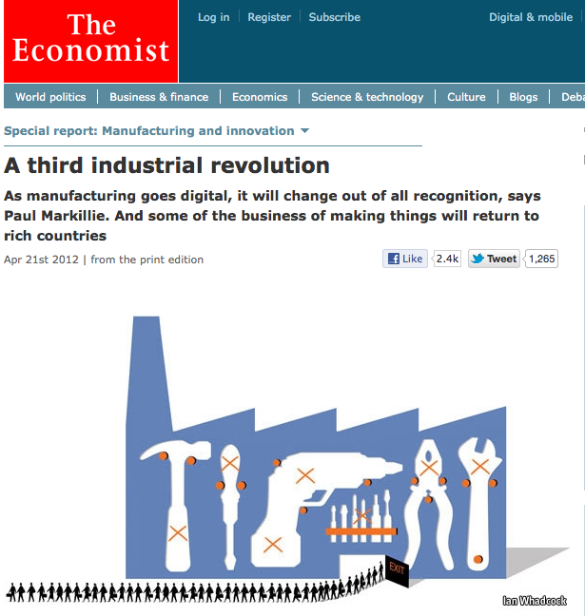
Notes:
http://www.economist.com/node/21552901
Mention Matt reading this on his iPad

Slide 31
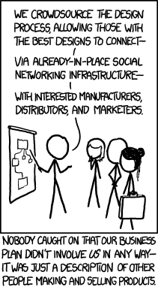
Notes:
http://imgs.xkcd.com/comics/crowdsourcing.png
We don't sell products; we sell the marketplace. And by 'sell the marketplace' we mean 'play shooters, sometimes for upwards of 20 hours straight.'

Slide 32
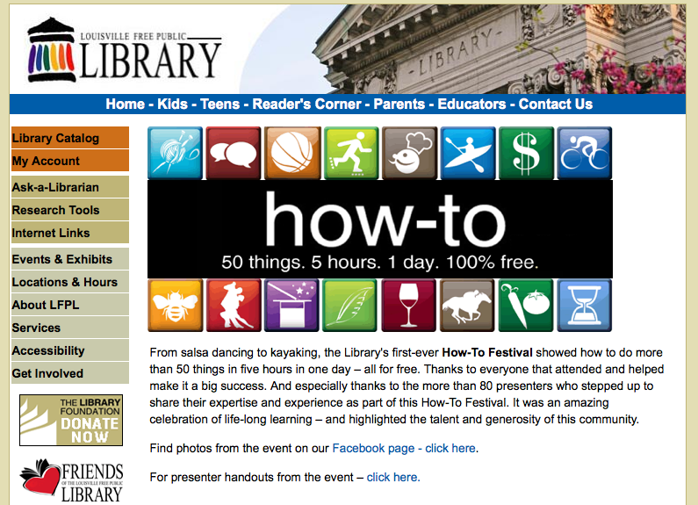
Notes:
Start simple - skillsharing
From salsa dancing to kayaking, the Library's first-ever How-To Festival showed how to do more than 50 things in five hours in one day – all for free. Thanks to everyone that attended and helped make it a big success. And especially thanks to the more than 80 presenters who stepped up to share their expertise and experience as part of this How-To Festival. It was an amazing celebration of life-long learning – and highlighted the talent and generosity of this community.
http://www.lfpl.org/how-to/

Slide 33
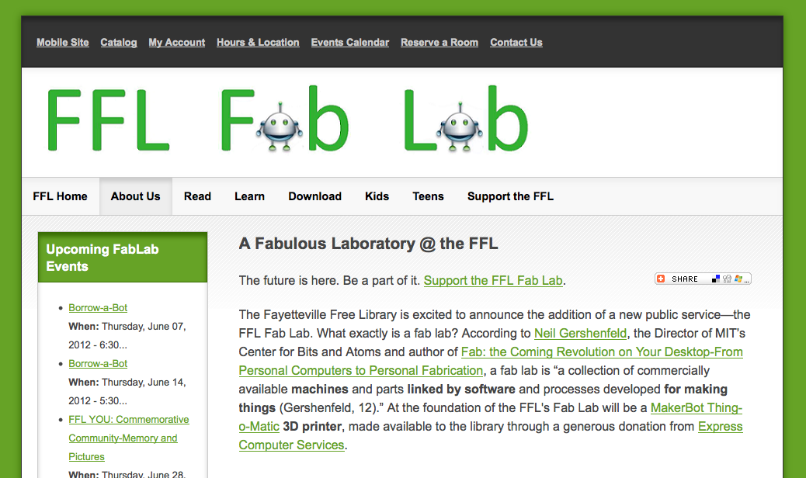
Notes:
http://www.fflib.org/about-us/services/fablab

Slide 34
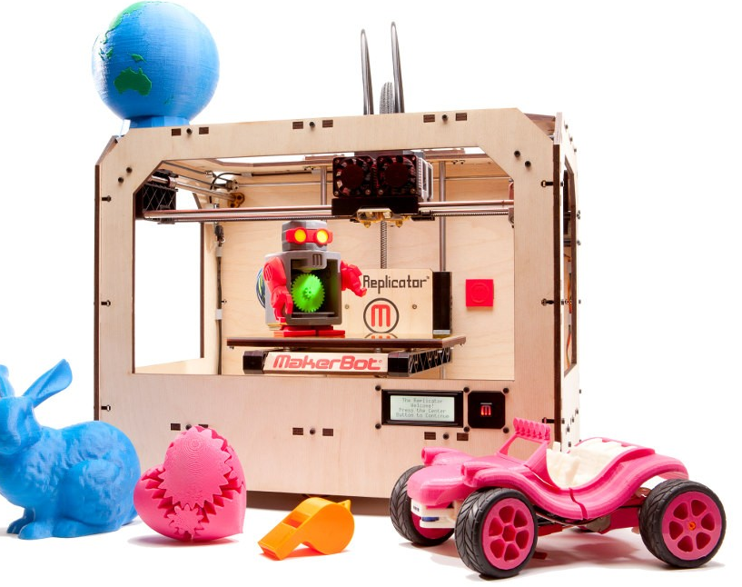
Notes:
Add image of CNC gantry

Slide 35
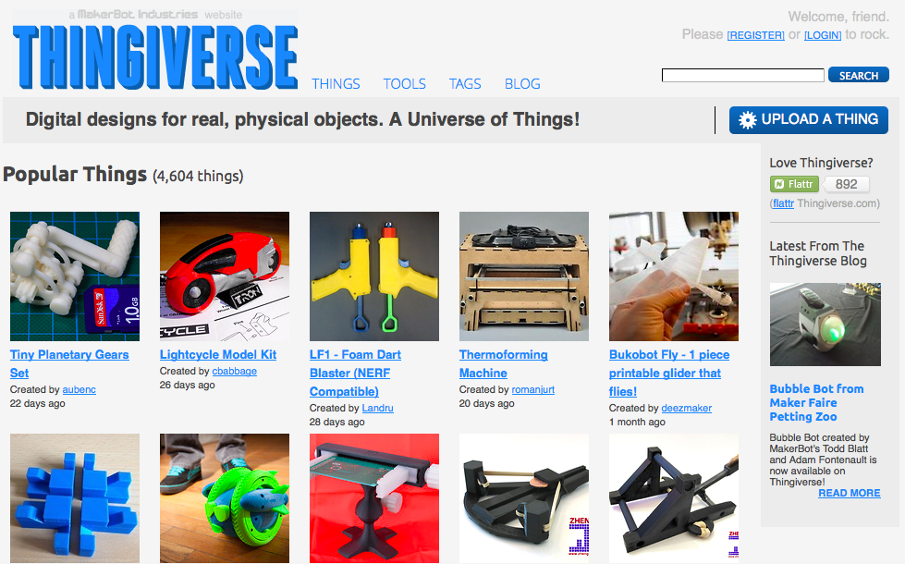

Slide 36
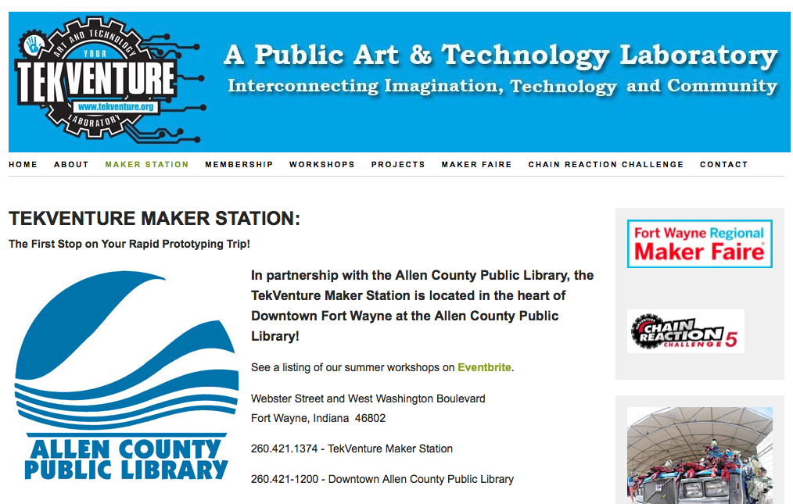
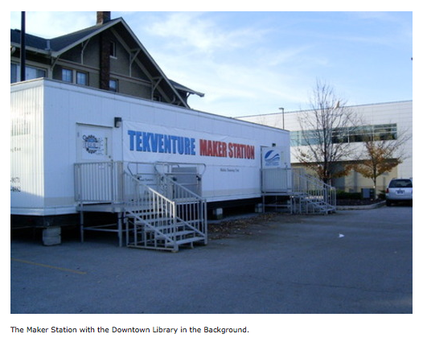
Notes:
Allen County, Fort Wayne, Indiana

Slide 37
Library Users as (Co-)Creators

Slide 38
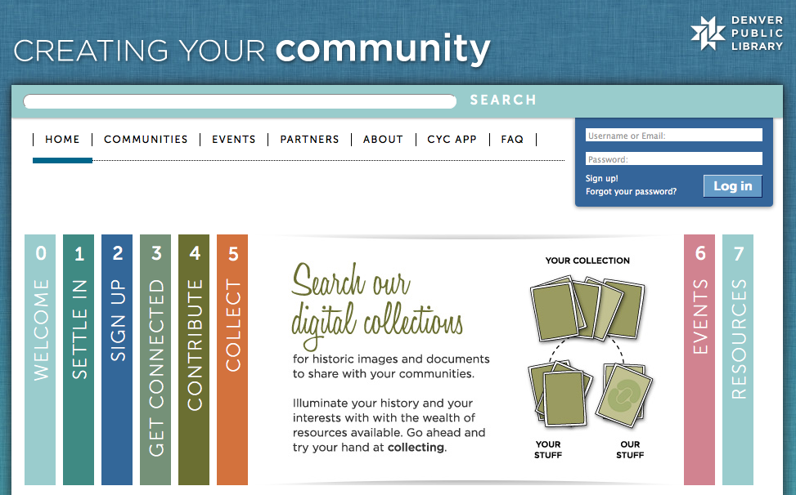
Notes:
http://creatingcommunities.denverlibrary.org

Slide 39
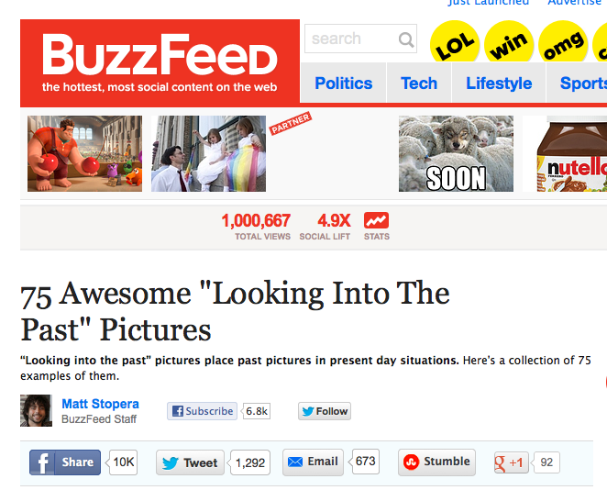
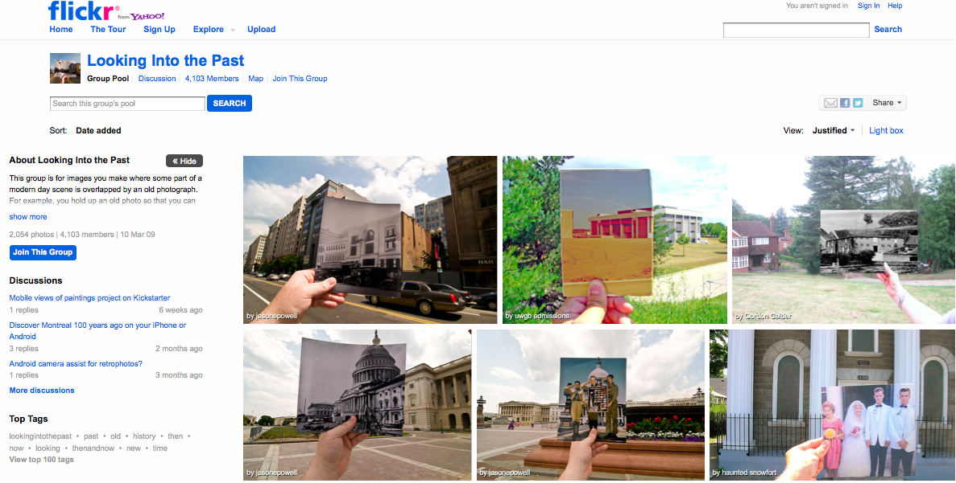
Notes:
Looking into the Past Flickr pool as found on Buzzfeed:
http://www.buzzfeed.com/mjs538/75-captivating-looking-into-the-past-pictures

Slide 40
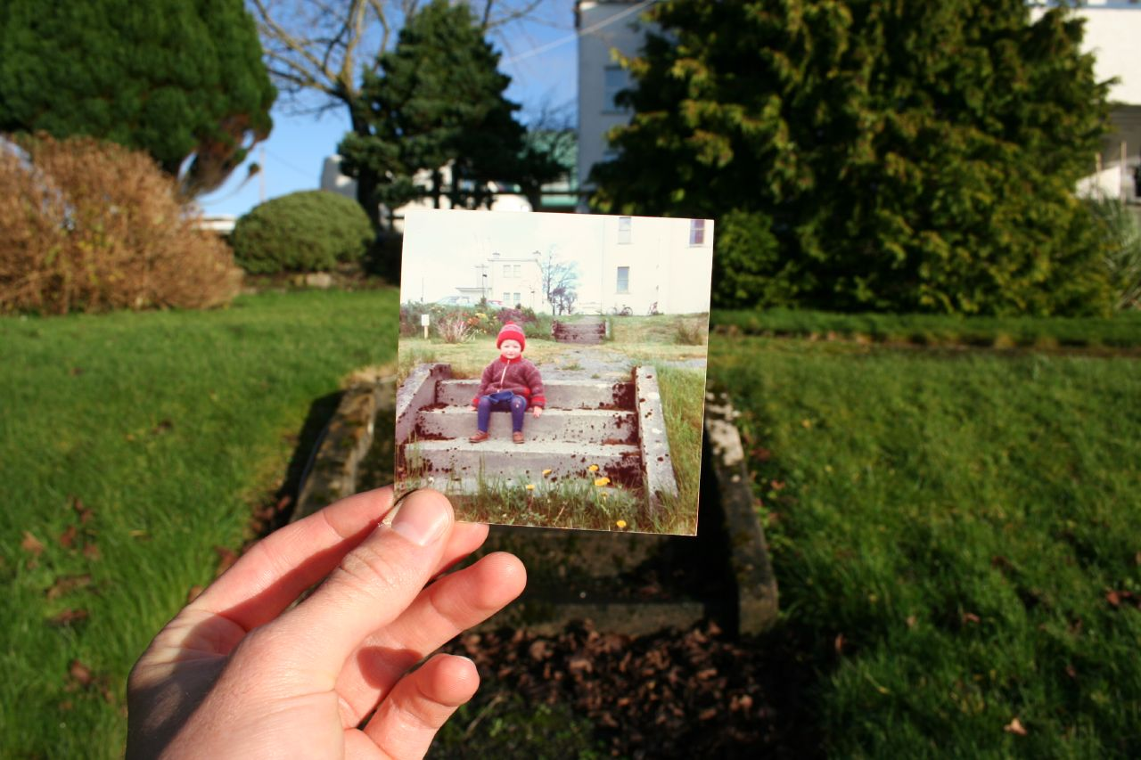
Notes:
http://www.flickr.com/photos/keithwoods/371679572/in/pool-1051492@N21/

Slide 41
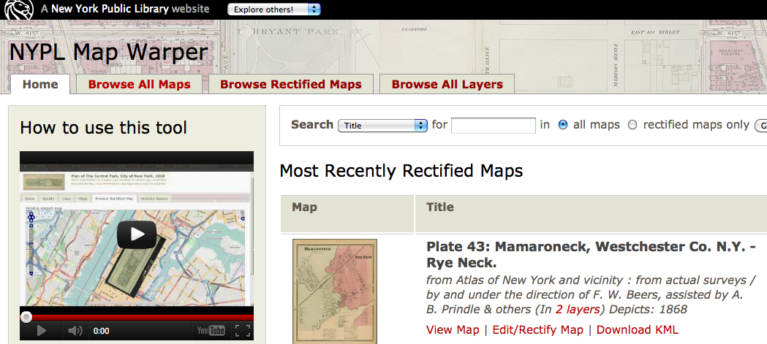
Notes:
NYPL maps

Slide 42
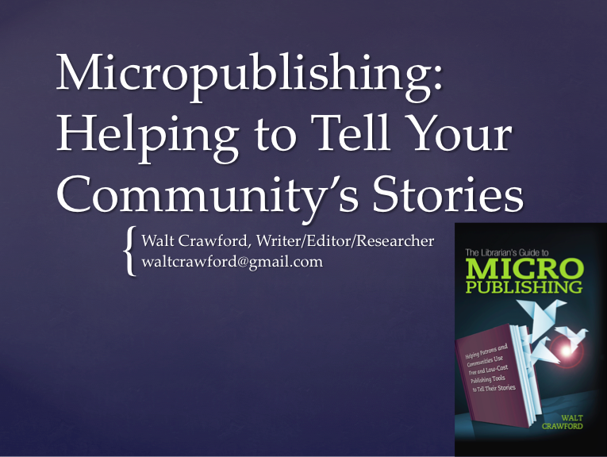

Slide 43
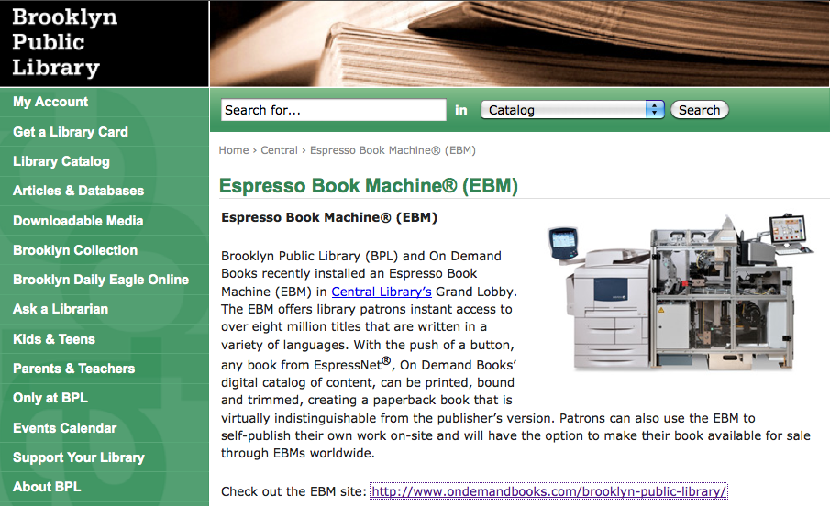
Notes:
Espresso machine – Brooklyn PL

Slide 44
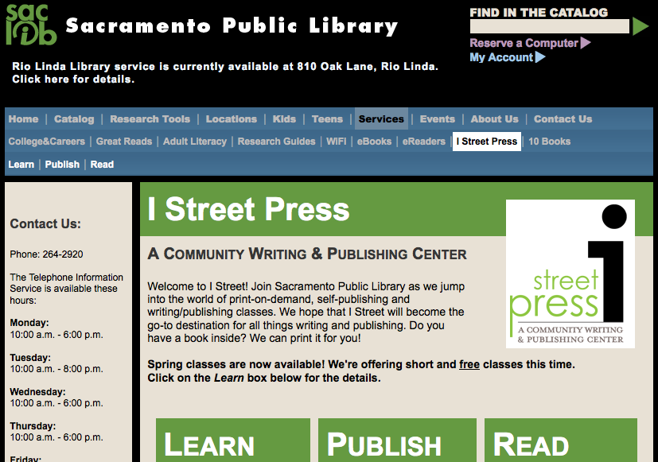
Notes:
iStreet Press – Sacramento Public Library

Slide 45
Notes:
http://www.epublishorbust.com/
Another attempt to create a book from start to finish within the library.

Slide 46
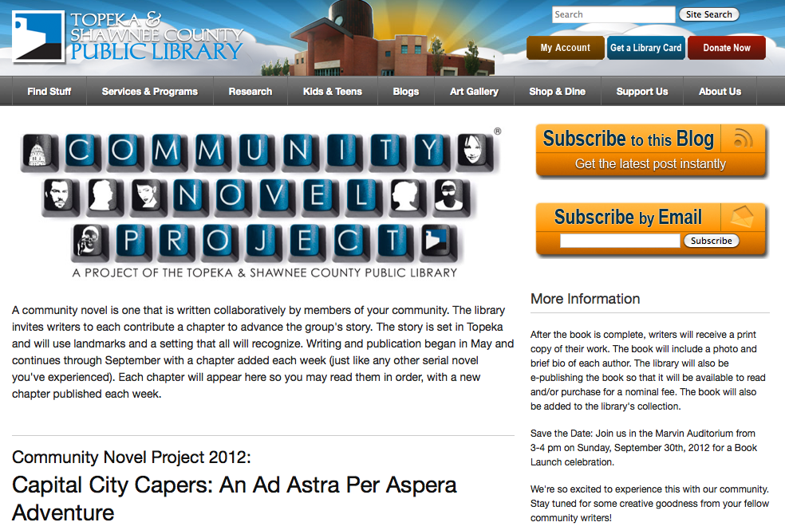
Notes:
Topeka Library crowdsourced novel

Slide 47
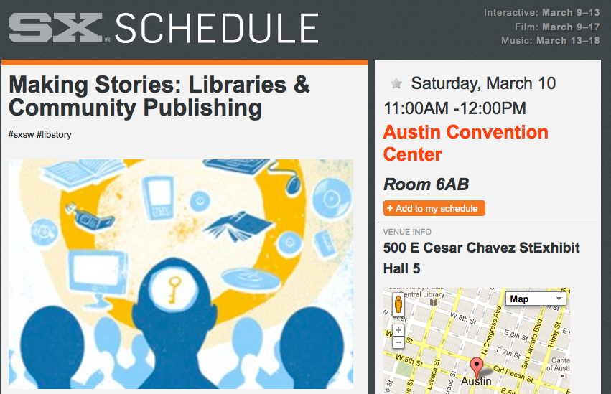
Notes:
Amy Buckland, Char Booth, Michael Porter, Nate Hill
http://www.slideshare.net/jambina/making-stories-libraries-community-publishing – look
http://schedule.sxsw.com/2012/events/event_IAP9273 - listen

Slide 48
The Future is Now

Slide 49
http://libraries.pewinternet.org/category/publications/survey-reports/

Slide 50
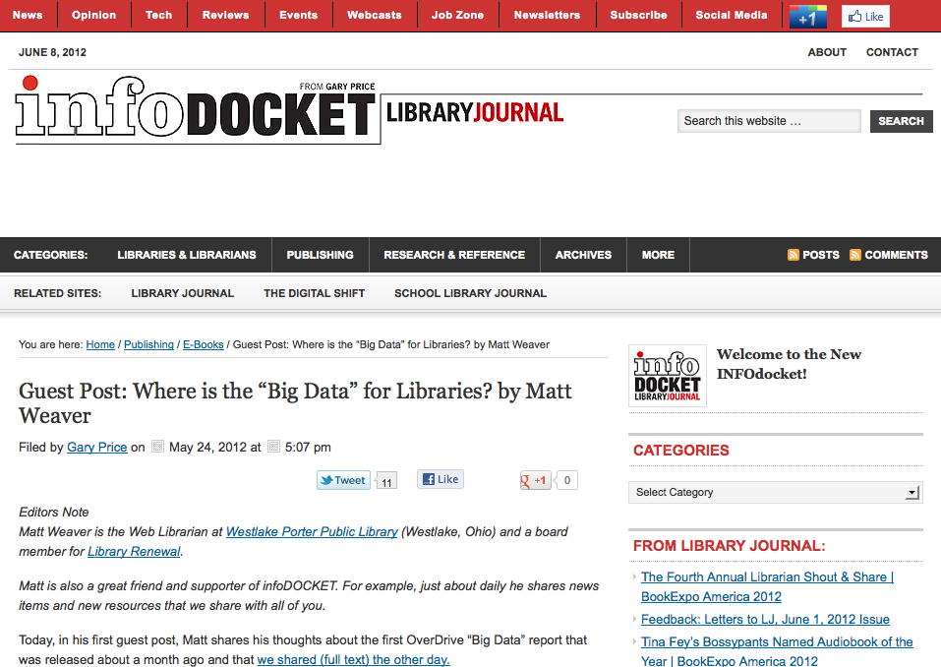
Notes:
InfoDocket – this just came out TODAY

Slide 51
Notes:
http://www.slideshare.net/edsonm/michael-edson-let-us-go-boldly-into-the-present-text-version

Slide 52
Thank you!
Jennifer Koerber
www.jenniferkoerber.com
jennifer.koerber@gmail.com

