Slide 1
Clio in the Cloud Version 2.0
Sue Kaler
&
Rick Levine

Slide 2
Agenda
Clio in the Cloud Version 2.0
The Virtual Catalog, the Commonwealth Catalog, Point to Point and Mediated Interlibrary Loan
WorldCat.org
Please ask questions via chat as we proceed

Slide 3
Run polls
How do you want to spend our time?
Mostly Clio
Mostly Point to Pont
Searching WorldCat.org
Regarding Clio 2.0, have you tried it?
If so, do you have any particular questions?
Put them in chat, please

Slide 4
Requesting Mediated ILL items
The request form is not changing
It is at http://cliowebhost.com/MassLibs/
Log in using your 29999 number as the library card number
Use ill (in lower case) as your password
Give as much bibliographic information as possible
Use the pull downs to indicate acceptable lender charges and shipping options

Slide 5
Consider using WorldCat.org
Some of you may have access to WorldCat via FirstSearch
Some of you may have this access linked to the MLS ILL system so you don’t have to fill out a form
We need a fairly complete citation
We love OCLC numbers or ISBN numbers

Slide 6
Recent slight tweaks to the request form
You will get an automatic email back when you send a request
We have divided postage options to tell us if Alaska and Hawaii are acceptable
We have change the wording to “Acceptable Lending Fee”
We have changed the wording to “Furthest Return Shipping”
This makes Delivery Only more visible

Slide 7
Updating via Clio in the Cloud version 2.0
Go to this URL: http://cliomasslibs.azurewebsites.net/Account/Login/
Login with your library nickname as both the user name and the password
This is just like you did in version 1.0 except you’re going to a different URL

Slide 9
The Borrowing Home Screen The top of the form
Go to box…a quick way to return to this home screen
Printouts pulldown
To batch print. Use Print Mine.
Hello xxxx….pulldown
manage account option (please don’t change your password)
Logout option

Slide 10
The Borrowing Home Screen Filters on the left of the form
New…recently requested
Pending…in the works
Attention, usually for the MLS staff
Shipped, good news!
On Loan….items we think you have
Returned….items you have sent back
Rec Copies….scans or photocopies
Cancelled….we will send email
Rejected….we do not use this status

Slide 11
The Borrowing Home Screen The Quick Search Box
You can find the item you desire from the lists
Or, you can enter a keyword search in the Quick Search Box, searching by:
ILL number or Clio number
Words from the title
Words from the author
Patron name does not work
Illiad transaction number does not work

Slide 12
Borrowing Lists
Can be sorted by column headers
ILLSysID is the ILL Request Number
Request Date
Due Date
Title….does not ignore initial articles
Branch….will be your library
Branch patron….will be whatever you entered
Select…an option for any item

Slide 14
Request Details
The Citation
Obvious fields except the External Request # IS the ILL Request Number
Please ignore the Action box
None of the options there are useful for us
Please do note the useful Print Box
Please do note the edit box for you or the MLS staff to add notes

Slide 15
Request Details, Lenders and Dates
Click anywhere in the light beige box that is the request
A lower flap opens up with many more useful details
The lender string and the actual lender
The dates upon which various actions happened with the request

Slide 16
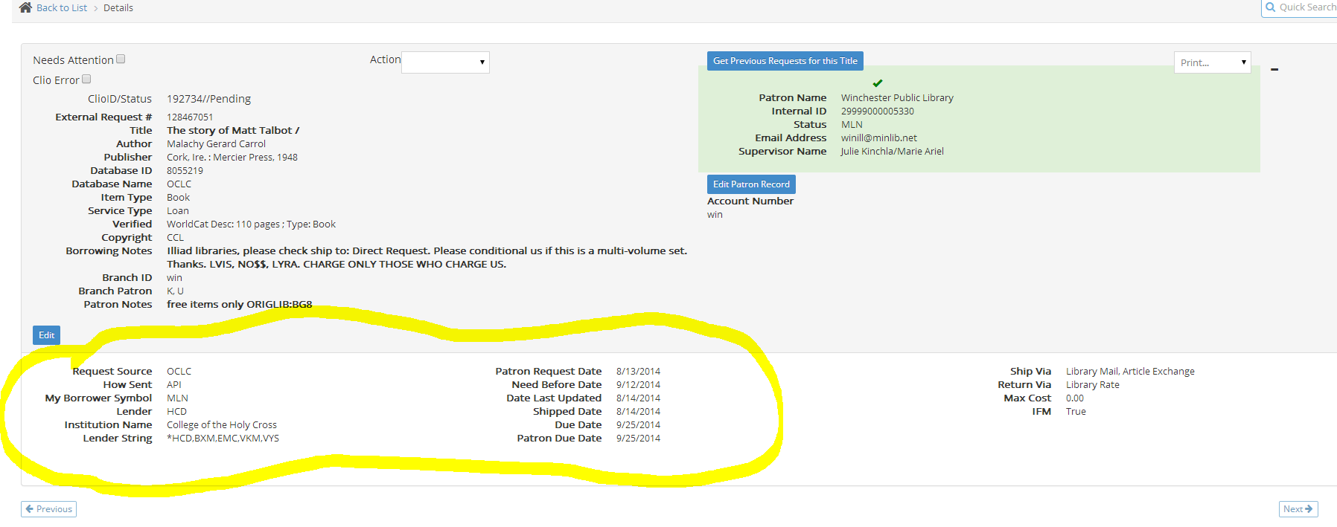

Slide 17
Updating to Received Loan
Click on the Update Options stripe below the request details
Select Received Loan
You can enter Lending Restrictions which will print on your bookstrap
Hit the Green Update button
The request will move to On Loan

Slide 18
Printing a Book Strap
You can do this from the print dropdown box on the upper right hand section of the request details
This option seems to work best
Or you can do it from the options while you are receiving the item
This should put it in the Printouts, Print Mine list
You may have to fix your popup blocker

Slide 19
Emailing Your Patron
Click on the Email Options stripe below the Update Options stripe
Your only email option will be to email the branch patron
If you have entered a branch patron email address it will autofill
You can enter an email address and edit the very generic message

Slide 20
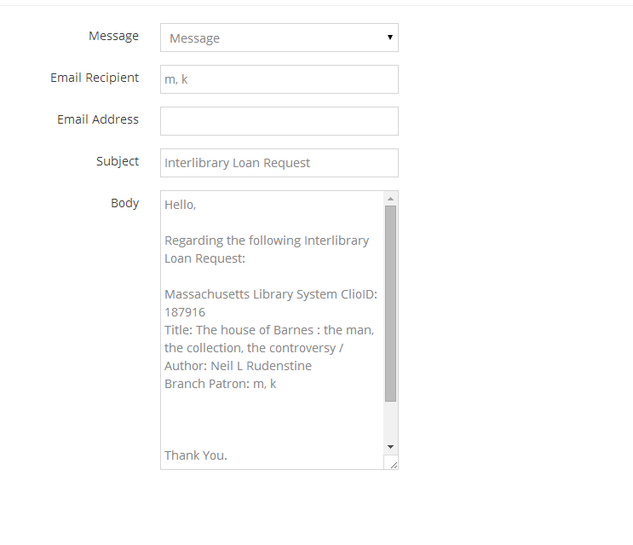

Slide 21
Requesting a Renewal
Find the item you want to renew
Click on the Update Options stripe below the request details
Select Renewal Request
Put your cursor in the Renewal Request Date box and select your desired new due date
Hit the green update box

Slide 22
Tracking Renewals
Look at the filters on the left of the Borrowing Home screen
Click On Loan
Note that there are sub categories of items On Loan
Attention, Recalled, Overdue, Renew OK, Renew No, Renew Pending, Due Soon (and Not Collected which we do not use)

Slide 23
The Renewal Process
If you have asked for a renewal, the item will be in Renew Pending
There also will be a checkmark in the Renewal Requested column of the On Loan list
If a renewal is granted, the item will move to Renew OK
If a renewal is denied it will move to Renew No

Slide 24
Due Dates (and Renewals)
The due date is supposed to mean the date the item is back at the lender’s
Almost everyone treats it as the date it begins its trip back to the lender
While you’re waiting for a renewal response, let the patron keep the item
No response is considered to be a granting of the renewal

Slide 25
Updating to Returned
Find the item you want to return
Click on the Update Options stripe below the request details
Select Returned
Hit the green Update Button
Contact the MLS if you need a good Return To Address

Slide 26
The Request History
This stripe is at the very bottom of each request
You can see the various processes the request has gone through
If we have emailed you, the text of the email will be included
You may have to hit Show Complete History to see everything

Slide 27
Contact the MLS
If you need to do something different than normal
If you have questions or issues with a request or in general
We are all firstname@masslibsystem.org
There is also ill@masslibsystem.org
We are option 4 on the telephone system

Slide 28
The VirtCat, the CommCat and Point to Point Requests
The Virtual Catalog is in the process of transitioning to the Commonwealth Catalog
During the transition, various networks and libraries will be unable to borrow from each other in a nicely automated and patron driven fashion at various time in the process

Slide 29
The Commonwealth Catalog
Will include everyone who was in the Virtual Catalog plus the MassCat libraries
Can be searched at http://commonwealthcatalog.org/MVC/
This link is for librarians only!

Slide 30
Options during the transition
Note that you are willing to go out of state and send your requests to the MLS via Clio
You may pay more in return postage, but may save in staff time
If you must have items on Delivery Only what to do depends upon what libraries own the item

Slide 31
Delivery Only owned by academics that were not on the VirtCat
Send your requests to the MLS via Clio
We’ll get your item from such places as Williams College, Wellesley College, etc. using OCLC
Although U Mass Amherst was at one time on the VirtCat, that has not been the case for quite a while. They are generous lenders via OCLC

Slide 32
Delivery Only owned by a C/W Mars library
C/W Mars did not participate in Point to Point so many of those member libraries will not know what is meant
Send your requests to the MLS via Clio and we will broker them for you
Some individual C/W Mars libraries may be fine with emailed requests.
If this is your experience, go for it!

Slide 33
Delivery Only owned by one of the other multi-type networks
Try sending a Point to Point request to the owning library
This may possibly be a sent via a form your network has set up for you
It may be an email asking to borrow the item in question from the owning library
The MLS has email contacts for many libraries which we are willing to share if you request them

Slide 34
What is the MLS role in Point to Point
We are willing to be a back up
If you are having difficulty, contact us
We are not staffed to take over all the traffic that the VirtCat used to create
That would give us no time to do our major process of requesting items from libraries that you cannot reach yourselves

